Slide 1

Intersectionality and Inclusive Pedagogies in Practice
Day 2 Workshop 4
Adnan Yilmaz, University of Stirling
Steve Brown, University of Glasgow
Notes:
Introduce myself and the workshop topic

Slide 2
Plan for this workshop
Lesson plan design for intersectionality and inclusive pedagogies
Final discussion
Wrap-up
Notes:
Talk through briefly

Slide 3
Material design for intersectionality and inclusive pedagogies
Context: Level? Age? Needs/goals? Interests?
Materials: Adapt existing ELT materials? Design a lesson around authentic materials? Create materials from scratch?
Tasks: Lead-in? Task-itself? Follow-up task? Language/skills focus? Stages and sequencing?
Note: Lesson plan template (insert the link)
Notes:
Before you start, these are some things that you will need to establish. As inclusiive pedagogies are very much context-dependent, it's important that you establish a very clear context before you start planning. As you adapted materials yesterday, the focus for today is on lesson planning. You can either do this by using authentic materials and developing tasks around them, or by creating your own materials from scratch. And of course, you will also need to consider the different stages and tasks to include in your lesson.

Slide 4
Material design for intersectionality and inclusive pedagogies
Work in groups of 4/5 people.
Choose a writer for your group.
Select a social justice issue that causes discrimination and/or social exclusion in your context.
Consider how intersectionality can lead to this issue affecting different individuals in different ways.
Design a lesson plan that addresses this issue by using intersectionality and inclusive pedagogies.
Use the lesson plan template (hyperlin Google Drive link) you are provided.
Share your lesson plan with us using the Google Forms (hyperlink Google Drive link) provided.

Slide 5
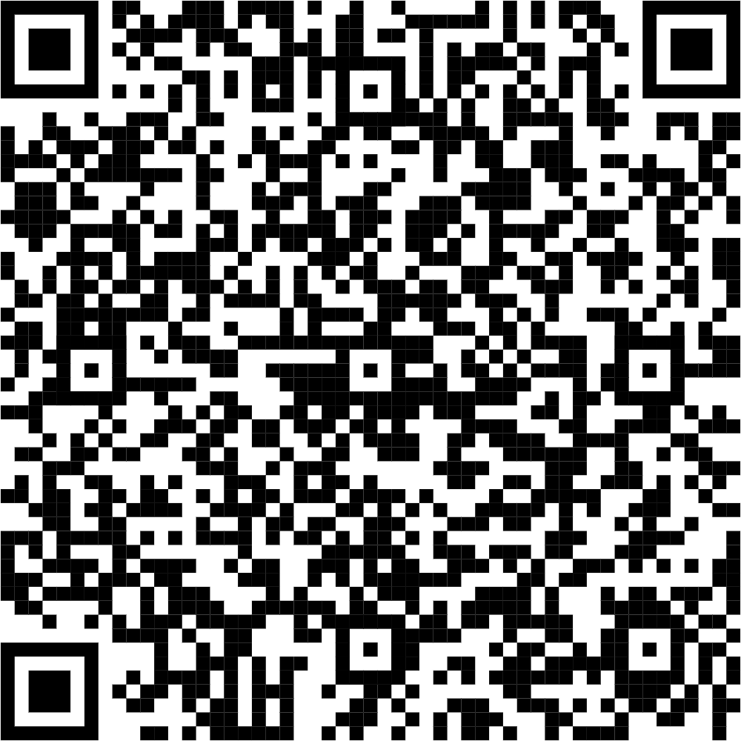
Material design for intersectionality and inclusive pedagogies
Lesson Plan Template
Insert the Google Drive QR code to enable access to the lesson plan template.
Google Forms
Insert the Google Forms QR code to collect lesson plans designed by participants.

Slide 6
Final discussion
How does the concept of intersectionality deepen our understanding of inclusivity in the classroom? Can you think of examples where this would be important in language education?
What was the most significant consideration your group kept in mind while designing the materials with intersectionality in mind? Why?
How do you see the lesson plan template supporting or limiting inclusive practices in your teaching context?
Reflecting on your material design process, what would you change or improve in future activities to better integrate inclusive and intersectional principles?

Slide 7
Overall discussion
What insights have you gained about your own assumptions or biases through these activities?
How do you envision applying what you’ve learned about social justice and inclusivity in your future teaching practices?
What additional support or resources do you think would be necessary to effectively implement these approaches in real-world classrooms?

Slide 8
Contact Information
Adnan Yilmaz, University of Stirling, UK
adnan.yilmaz@stir.ac.uk
Servet Celik, Trabzon University, Türkiye
servet61@trabzon.edu.tr
Samina Rana, Higher Education Department, Pakistan
saminarana09@gmail.com
https://justpedagogies.stir.ac.uk/

