Slide 1


Inclusive and social justice-oriented pedagogies in English language classrooms: Insights from Türkiye, Pakistan, and the UK
Day 1 Workshop 1
Adnan Yilmaz
University of Stirling
22-23 February 2025

Slide 2
Flow
Introductions
Project overview
What is social justice?
What is social justice language education?
Critical literacy and material evaluation
Time for practice
Towards language education for social justice: A call for action in the EFL writing classroom
March 21, 2022
Workshop Series at the University of Stirling, UK
22-23 February 2025

Slide 3
1
Workshop Series at the University of Stirling, UK
22-23 February 2025
Introductions

Slide 4
The project team
From the UK:
Adnan Yılmaz, University of Stirling
Deniz Ortaçtepe Hart, University of Glasgow
Steve Brown, University of Glasgow
Aiman Jamilah Abdul Rahman, University of Stirling
From Pakistan:
Samina Rana, Higher Education Department, Punjab
Shahabullah, Abbottabad University Of Science & Technology
Malik Ajmal Gulzar, Allama Iqbal Open University
From Türkiye:
Servet Çelik , Trabzon University
Bilal Karaca, Trabzon University
Towards language education for social justice: A call for action in the EFL writing classroom
March 21, 2022
Workshop Series at the University of Stirling, UK
22-23 February 2025
https://justpedagogies.stir.ac.uk/

Slide 5
Let’s learn about you…
Full name
Affiliation
Reasons for being interested in social justice issues or this project
Towards language education for social justice: A call for action in the EFL writing classroom
March 21, 2022
Workshop Series at the University of Stirling, UK
22-23 February 2025
https://justpedagogies.stir.ac.uk/

Slide 6
Warm-up activity: Paper folding
Fold the paper in half.
Fold the paper in half again.
Tear off the bottom right corner.
Turn the paper upside down.
Tear off the other bottom right corner.
United States Institute of Peace (n.d.)
Towards language education for social justice: A call for action in the EFL writing classroom
March 21, 2022
Workshop Series at the University of Stirling, UK
22-23 February 2025
Notes:
https://www.usip.org/public-education-new/paper-folding-activity

Slide 7
Warm-up activity: Paper folding
What do you notice?
How did you feel comparing your paper to others? Did anyone think they did it wrong?
Why were there so many interpretations of the same instructions?
If the paper represents your perspective, what does this activity say about perspectives?
Why is it useful to see things differently? What can we learn from different viewpoints?
Towards language education for social justice: A call for action in the EFL writing classroom
March 21, 2022
Workshop Series at the University of Stirling, UK
22-23 February 2025

Slide 8
2
Workshop Series at the University of Stirling, UK
22-23 February 2025
Project Overview

Slide 9

Purpose of the project
To investigate the integration of inclusive and social justice-oriented pedagogies in language teacher education by focusing on pre-service English language teachers and teacher educators from three underrepresented geographical and cultural contexts in the literature: Türkiye, Pakistan, and Scotland (UK)
Towards language education for social justice: A call for action in the EFL writing classroom
March 21, 2022
Workshop Series at the University of Stirling, UK
22-23 February 2025
https://justpedagogies.stir.ac.uk/

Slide 10
Project milestones
An online transnational kick-off meeting (August 2024)
Pre-workshop data collection (October 2024 - January 2025)
Online transnational colloquium (December 2024)
In-person and online workshops (January-February 2025)
Post-workshop data collection (March-April 2025)
Online multiplier event (May 2025)
Towards language education for social justice: A call for action in the EFL writing classroom
March 21, 2022
Workshop Series at the University of Stirling, UK
22-23 February 2025
https://justpedagogies.stir.ac.uk/

Slide 11
3
Workshop Series at the University of Stirling, UK
22-23 February 2025
What is social justice?

Slide 12
Reasons for learning another language
To acquire educational excellence
Education
To gain prestige
01
Proficiency
Prestige
To be a proficient speaker
07
02
Towards language education for social justice: A call for action in the EFL writing classroom
March 21, 2022
Workshop Series at the University of Stirling, UK
22-23 February 2025
06
03
To develop global and intercultural competence
To secure better jobs
Jobs
Competence
05
04
To meet workplace demands
Workplace
Interaction
To interact respectfully and responsively with target communities

Slide 13

Language teacher education
Based on the aforementioned reasons for learning another language:
there is a high demand for teachers to effectively support English language learners, despite limited consensus on best practices in educational literature.
almost all teachers across all regions and disciplines must be equipped to educate students from diverse linguistic and cultural backgrounds.
Towards language education for social justice: A call for action in the EFL writing classroom
March 21, 2022
Workshop Series at the University of Stirling, UK
22-23 February 2025

Slide 14

Problems in language teacher education
Often newly qualified teachers of English may demonstrate sensitivity to individual learners' abilities and weaknesses and organize learning activities that expose learners to simulated acquisition-rich situations. They are keen to organize drama, debate, writing and other activities and offer genuine feedback on performance. But as they gain experience and make sense of their work environment, they soon lose confidence in their own efforts when they cannot determine how to meet the specific learning needs. And this is especially because the system demands good grades from everyone and does not cater to individuals. The teachers resort to the routines prescribed by the examination syllabus, anxious to identify with their immediate social groups in the schools that evaluate them. They feed students on the discrete grammar of English, composition writing in the form of creative writing and reading comprehension without much care for the functional approach. (Kyeyune, 2011, p. 91 in Hawkins, 2011)
Towards language education for social justice: A call for action in the EFL writing classroom
March 21, 2022
Workshop Series at the University of Stirling, UK
22-23 February 2025

Slide 15

Defining ‘social justice’
      Q1- What keywords do you think of when you hear the phrase ‘social justice’?
Towards language education for social justice: A call for action in the EFL writing classroom
March 21, 2022
Workshop Series at the University of Stirling, UK
22-23 February 2025
Insert the Mentimeter QR code to elicit responses.

Slide 16

Defining “social justice”
      “a philosophy, an approach, and actions that embody treating all people with fairness, respect, dignity, and generosity” (Nieto, 2010, p. 46)
“a commitment to equity and equality for all people in society” (Garmon, 2004, p. 206)
Towards language education for social justice: A call for action in the EFL writing classroom
March 21, 2022
Workshop Series at the University of Stirling, UK
22-23 February 2025

Slide 17

Defining “social justice”
“social justice is an individual, collective, and institutional journey that involves self-identity awareness, learning with students, developing meaningful relationships, developing multilingual/multicultural knowledge, challenging racism and other biases, having a critical stance, and working with a community of critical friends” (Nieto, 2000, p. 5; cited in Grant & Agosto, 2008, p. 187)
Towards language education for social justice: A call for action in the EFL writing classroom
March 21, 2022
Workshop Series at the University of Stirling, UK
22-23 February 2025

Slide 18
Why???
Why do we talk about social justice in relation to education/language teaching?
“Why should I talk about social justice in my classes?”
Why am I in this project?
Towards language education for social justice: A call for action in the EFL writing classroom
March 21, 2022
Workshop Series at the University of Stirling, UK
22-23 February 2025
Notes:
Back in March 2019 during TESOL, when I told someone that I was running a project in Turkey on language teaching for social justice, they asked me so why should I talk about social justice in my classes? I tried to explain how language classes provide excellent contexts to discuss these issues because whether we admit it or not, we are not only teaching a language but delivering content as well. Then I said, for instance, you teach your students about the animals that they will never see in their lives and the food that they will never eat. You are also teaching them how to behave at a restaurant and how to address their professors etc. There’s always hidden agenda, a hidden curriculum behind the colorful pictures of the coursebooks. Why wouldn’t you use this opportunity to actually teach something more helpful for the society? He seemed convinced but this answer was only the tip of the iceberg of the answers that I could give at that point. If I had the time back then, I would also talk about this English teacher who gave a worksheet to their students to teach them the barn animals.

Slide 19
What is social justice language education?
4
Workshop Series at the University of Stirling, UK
22-23 February 2025

Slide 20

Defining ‘social justice language education’
      Q2- What does ‘social justice language education’ mean?
Towards language education for social justice: A call for action in the EFL writing classroom
March 21, 2022
Workshop Series at the University of Stirling, UK
22-23 February 2025
Insert the Mentimeter QR code to elicit responses.

Slide 21
Social justice language education
(n):
equity, ethical values, care & respect
creating equitable and inclusive schooling and education
by examining issues of race, diversity, gender, age, class, ability, and sexual identity from a critical perspective
by cultivating a sense of advocacy and activism for social, cultural, and economic transformation.
Towards language education for social justice: A call for action in the EFL writing classroom
March 21, 2022
Workshop Series at the University of Stirling, UK
22-23 February 2025
(v):
a goal and a process
Notes:
https://www.menti.com/ald85atawy7u

Slide 22
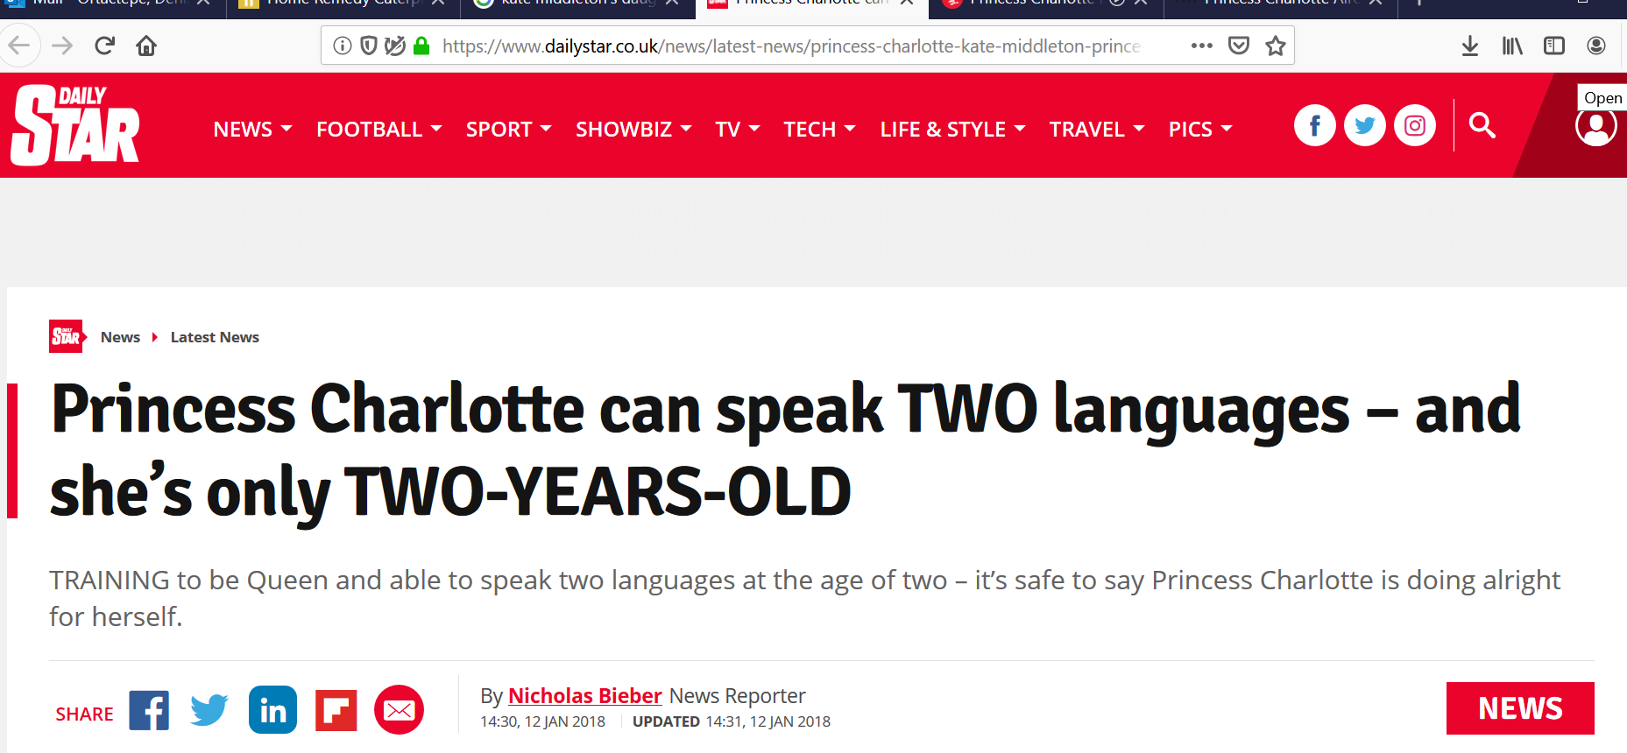
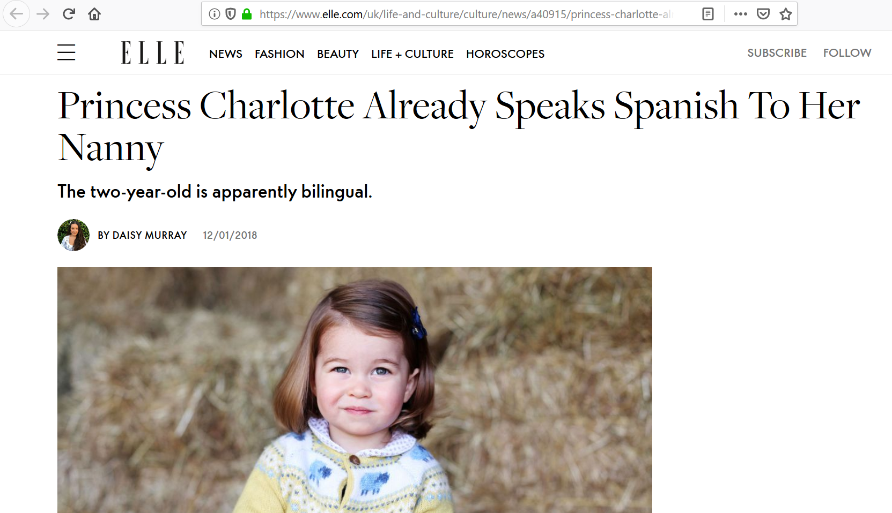
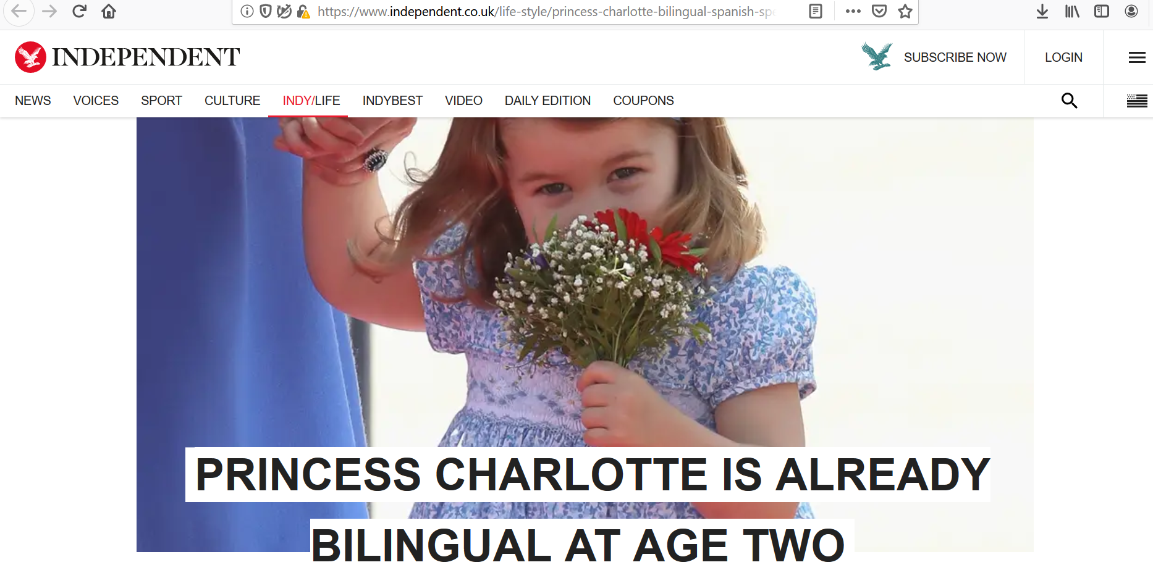
Bilingualism and migration
Towards language education for social justice: A call for action in the EFL writing classroom
March 21, 2022
Workshop Series at the University of Stirling, UK
22-23 February 2025

Slide 23
Social justice language education
      Underlying frameworks
Critical pedagogy
Anti-racist pedagogy
Feminist pedagogy
Anti-oppressive education
Critical language awareness
Critical applied linguistics
Critical multicultural education
Culturally responsive/sustaining pedagogies
Towards language education for social justice: A call for action in the EFL writing classroom
March 21, 2022
Workshop Series at the University of Stirling, UK
22-23 February 2025

Slide 24
Social justice language education
      Everything involved in the teaching/learning process:
Beliefs, values, and ideologies
The curriculum and language learning policies (i.e. hidden curriculum)
Teaching approaches, methods, strategies, and techniques
Lesson planning, setting up objectives and goals
Textbooks and various multimodal materials
The questions, the decisions, and the interaction patterns in the classroom
The relationship with and advocacy for students, parents, colleagues and communities
Towards language education for social justice: A call for action in the EFL writing classroom
March 21, 2022
Workshop Series at the University of Stirling, UK
22-23 February 2025

Slide 25
Critical Literacy and Materials Evaluation
5
Workshop Series at the University of Stirling, UK
22-23 February 2025

Slide 26

Critical literacy
      The practice of challenging texts through a critical analysis (Frey & Fisher, 2005, p.1)
      Critical analysis of visual, aural, and digital multimodal texts and reflection to transform relations of cultural, social, and political power
      The use of texts in a range of communications to analyse, critique, represent and alter inequitable knowledge structures and social relations of school and society (Luke & Dooley, 2011, p. 856)
Towards language education for social justice: A call for action in the EFL writing classroom
March 21, 2022
Workshop Series at the University of Stirling, UK
22-23 February 2025

Slide 27
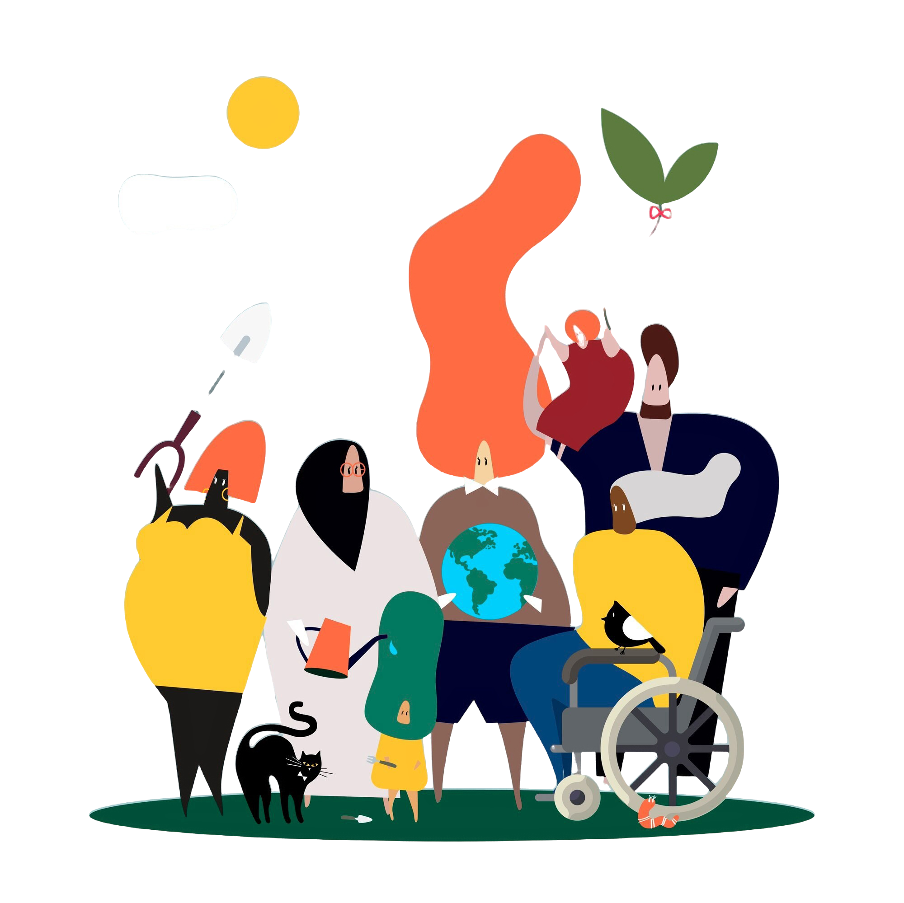
The hidden curriculum behind textbooks
Textbooks as ideological tools:
tend to endorse and reproduce the existing power relations in the society (i.e., social class, race, gender, and sexual orientation, able-bodiness) (Bori, 2020; Risager, 2021; Shin, Eslami, & Chen, 2011; Tajeddin & Teimournezhad, 2015).
Textbooks as cultural artefacts:
reflect ways of being, ways of speaking in other languages/cultures, as well as the values attached to it (Canale, 2016; Gray, 2010; Vinall & Shin, 2019).
Towards language education for social justice: A call for action in the EFL writing classroom
March 21, 2022
Workshop Series at the University of Stirling, UK
22-23 February 2025

Slide 28

The hidden curriculum behind textbooks
P
A
R
S
N
I
P
olitics
lcohol
eligion
ex
arcotics
“sm” (e.g., communism, atheism…)
ork
Towards language education for social justice: A call for action in the EFL writing classroom
March 21, 2022
Workshop Series at the University of Stirling, UK
22-23 February 2025
Thornbury, 2010

Slide 29
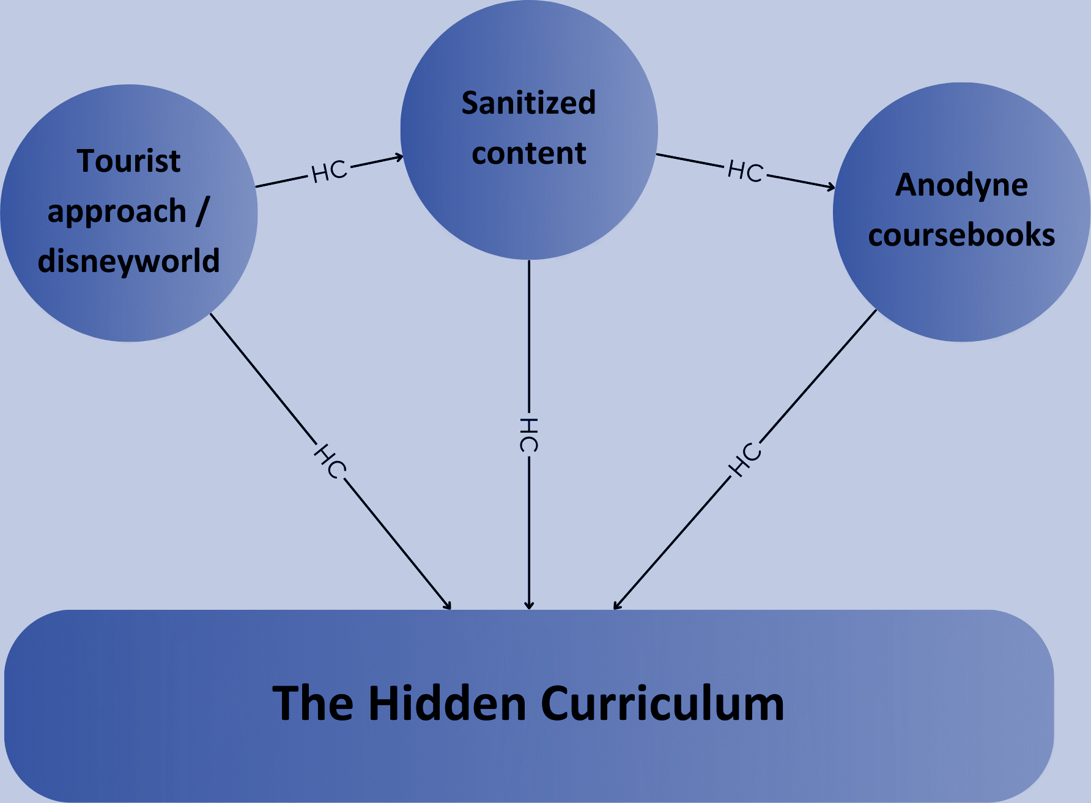
The hidden curriculum behind textbooks
Towards language education for social justice: A call for action in the EFL writing classroom
March 21, 2022
Workshop Series at the University of Stirling, UK
22-23 February 2025
“the soft, fudgy, sub-journalistic … world of EFLese course materials"
(Mario Rinvolucri, cited in Thornbury, 2010).

Slide 30
Common themes that occur in traditional textbooks
# | Themes | Topics
1 | School | classes, supplies and materials, schedules
2 | House | furniture, rooms, chores
3 | Clothing | shopping, clothing items, colors, styles
4 | Health | Illnesses, going to the doctor
5 | Travel | Hotel, transportation
6 | City | Places found in a city, leisure time activities
7 | Education and Work | Professions, education system
8 | Relationships | Family, friends, marriage, divorce
9 | Environment | Recycling, responsibilities, natural and manmade disasters
Towards language education for social justice: A call for action in the EFL writing classroom
March 21, 2022
Workshop Series at the University of Stirling, UK
22-23 February 2025

Slide 31
Environmental education and justice
Traditional ESL/EFL Topic | Environmental Angle
Transportation | Carbon emissions Car-free cities
Food | Industrial agriculture and meat production Organic and community gardening Genetically modified organisms
Tourism | Environmental impacts of traditional tourism Ecotourism Local green directory
Business | Sustainable business case studies Environmental impacts of famous companies True cost economics
Marketing | Greenwashing Label reading
Towards language education for social justice: A call for action in the EFL writing classroom
March 21, 2022
Workshop Series at the University of Stirling, UK
22-23 February 2025
Notes:
Royal, 2016, p. 283

Slide 32
Environmental education and justice
Art/Literature | Representations of nature Ecohumanities
Psychology/Sociology | Consumerism and mental health Nature-deficit disorder
Health | Effects of pollution/indoor air pollution Effects of biking, walking vs. driving Effects of eating less meat/processed food
Weather | Climate change Use of climate control
Technology | Mining precious metals Recycling and disposal of toxic materials
Hobbies/Interests | The prevalence of consumption-based hobbies Environmental impacts of different hobbies
Housing | Environmental footprint Average house size around the world Natural building/Green building
Towards language education for social justice: A call for action in the EFL writing classroom
March 21, 2022
Workshop Series at the University of Stirling, UK
22-23 February 2025
Notes:
Royal, 2016, p. 283

Slide 33
6
Workshop Series at the University of Stirling, UK
22-23 February 2025
Time for Practice

Slide 34
A critical framework for material evaluation and adaptation
Part I: Describe the material, the context, and learners
Part II: Evaluation of the material
2.1. Evaluating the material from the teacher’s perspective
2.2. Evaluating the material from the students’ perspectives
2.3. Evaluating the material in terms of praxis
Part III: Adaptation
Ortactepe Hart, 2023
Towards language education for social justice: A call for action in the EFL writing classroom
March 21, 2022
Workshop Series at the University of Stirling, UK
22-23 February 2025

Slide 35
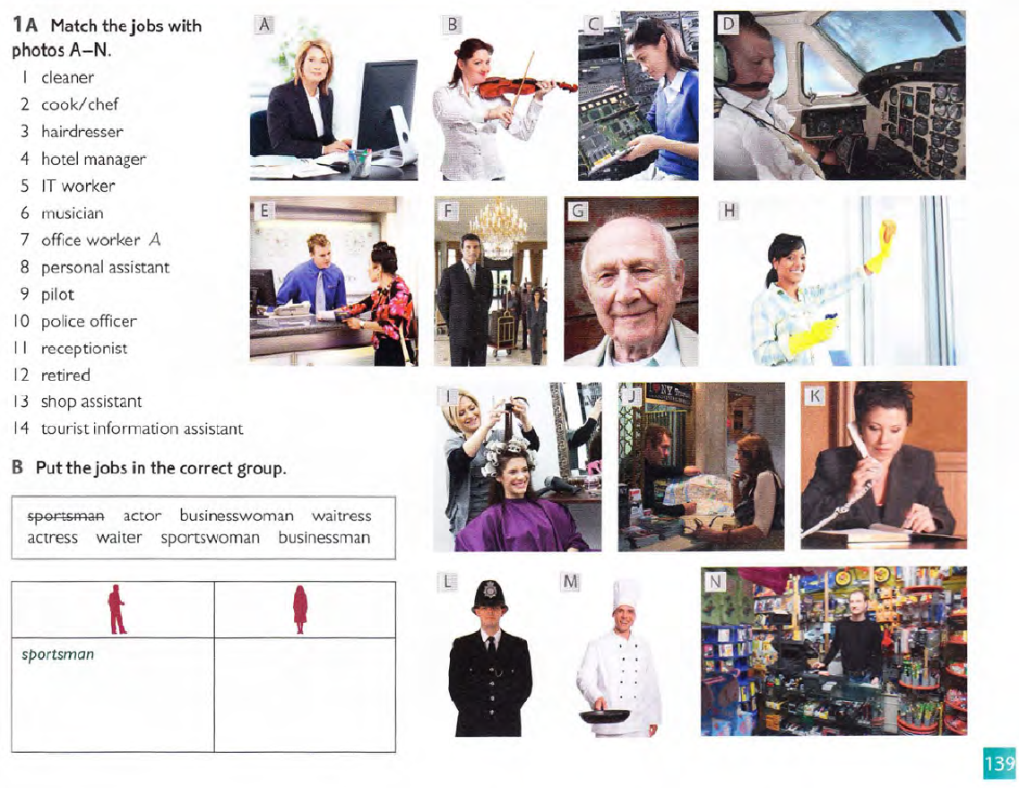
Who is doing what?
What common professions are taught when we teach vocabulary about professions?
What professions are not taught? Which words are privileged?
What do the visual representations used in the textbook, on posters, on worksheets, or on visual flash cards say about who typically works in each profession?
Towards language education for social justice: A call for action in the EFL writing classroom
March 21, 2022
Notes:
Glynn et al., 2014, p. 7

Slide 36
Part I: Describe the material, the context, and learners
Material: A textbook page that involves matching job titles to photos (Task A) and categorizing jobs (Task B)
Learning Goals: To help learners develop vocabulary related to professions and enhance their ability to categorize and identify jobs based on context
Target Population:
Age: Likely adolescents or adults
Educational Level: Pre-intermediate English learners
Language Proficiency: Pre-intermediate
Language Background: Learners from diverse linguistic and cultural backgrounds
Goals: To enhance practical vocabulary for jobs and to improve visual-literacy skills by matching images to job descriptions
Towards language education for social justice: A call for action in the EFL writing classroom
March 21, 2022
Workshop Series at the University of Stirling, UK
22-23 February 2025

Slide 37
Part II: Evaluation of the material
2.1. From the Teacher’s Perspective
Teacher’s Take: The material is straightforward and practical for vocabulary building. However, it may oversimplify complex concepts of work and identity.
Intention: Likely created to provide a light and engaging introduction to job-related vocabulary.
Preparation: Teachers should anticipate student questions about job roles unfamiliar to them and prepare culturally relevant examples.
Towards language education for social justice: A call for action in the EFL writing classroom
March 21, 2022
Workshop Series at the University of Stirling, UK
22-23 February 2025

Slide 38
Part II: Evaluation of the material
2.2. From the Students’ Perspective
Appropriateness: May not fully reflect the cultural or socio-economic diversity of the student population.
Cultural Relevance: While relatable to some learners, the material risks being Eurocentric or stereotypical in its depiction of professions.
Potential Differing Views: Students may interpret the roles and stereotypes differently based on their backgrounds (e.g., a “chef” might be depicted as a male role, which might not align with all students' views).
Towards language education for social justice: A call for action in the EFL writing classroom
March 21, 2022
Workshop Series at the University of Stirling, UK
22-23 February 2025

Slide 39
Part II: Evaluation of the material
2.3. Praxis Considerations
Biases: The material appears to privilege Western-centric job portrayals, with limited representation of diverse cultures and non-traditional career paths.
Stereotypes: Some photos risk perpetuating gender norms (e.g., women as receptionists or assistants, men in professional or authoritative roles).
Voices and Realities: Eurocentric and middle-class realities seem foregrounded; realities of jobs in non-Western settings or among marginalized groups are absent.
Representation: Limited diversity in the portrayal of ethnicities, gender roles, and socio-economic backgrounds.
Towards language education for social justice: A call for action in the EFL writing classroom
March 21, 2022
Workshop Series at the University of Stirling, UK
22-23 February 2025

Slide 40
Part III: Adaptation
Adding Social Justice Objectives
Discuss non-stereotypical roles in professions (e.g., women in STEM, male nurses, or diverse family-run businesses).
Encourage students to explore how job opportunities differ across cultures and socio-economic contexts.
Supplementing Content
Include images and descriptions of jobs from non-Western or diverse cultural contexts.
Provide examples of job titles in emerging fields, such as technology or climate-focused careers.
Towards language education for social justice: A call for action in the EFL writing classroom
March 21, 2022
Workshop Series at the University of Stirling, UK
22-23 February 2025

Slide 41
Part III: Adaptation
Encouraging Critical Analysis
Pose questions: “Why do you think these professions are depicted this way?” or “What jobs do you think are missing, and why?”
Facilitate discussions on gender roles and cultural stereotypes in professions.
Integration of Authentic Materials
Use videos or articles showing real people discussing their jobs across different cultures.
Incorporate interviews with professionals from diverse backgrounds.
Towards language education for social justice: A call for action in the EFL writing classroom
March 21, 2022
Workshop Series at the University of Stirling, UK
22-23 February 2025

Slide 42
Part III: Adaptation
Promoting Multimodality
Add audio files of people describing their jobs.
Include visual or dramatic activities, like role-playing a day in a worker’s life.
Investigating Larger Issues
Discuss how job opportunities and access differ globally.
Analyze the impact of automation and globalization on job markets.
Equitable Perspectives
Add more inclusive visuals representing different ethnicities, ages, genders, and abilities in a range of professions.
Ensure all professions are valued equally, from cleaners to CEOs.
Towards language education for social justice: A call for action in the EFL writing classroom
March 21, 2022
Workshop Series at the University of Stirling, UK
22-23 February 2025

Slide 43
References
Bori, P. (2020). Neoliberalism and global textbooks: a critical ethnography of English language classrooms in Serbia. Language, Culture and Curriculum, 34(2), 183–198.
Canale, G. (2016). (Re)Searching culture in foreign language textbooks, or the politics of hide and seek. Language, Culture and Curriculum, 29(2), 225–243.
Frey, N., & Fisher, D. (2005). The role of critical literacy in citizenship. RHI: Promoting Active Citizenship, 2(1), 13-20.
Garmon, M. A. (2004). Changing Preservice Teachers’ Attitudes/Beliefs About Diversity: What are the Critical Factors? Journal of Teacher Education, 55(3), 201-213.
Glynn, C., Wesely, P. & Wassell, B. (2014). Words and actions: Teaching languages through the lens of social justice. ACTFL.
Grant, C. A., & Agosto, V. (2008). Teacher capacity and social justice in teacher education. In M. Cochran-Smith, S. Feiman-Nemser, J. McIntyre, & K. E. Demers (Eds.), Handbook of research on teacher education: Enduring questions in changing contexts (3rd ed., pp. 175-200). Routledge.
Hawkins, M. R. (Ed.). (2011). Social justice language teacher education. Tonawanda, NY: Multilingual Matters.
Towards language education for social justice: A call for action in the EFL writing classroom
March 21, 2022
Workshop Series at the University of Stirling, UK
22-23 February 2025

Slide 44
References
Luke, A., & Dooley, K. (2011). Critical Literacy and Second Language Learning. In E. Hinkel (Ed.), Handbook of Research in Second Language Teaching and Learning: Volume 2 (1st ed., pp. 856-867). Routledge.
Nieto, S. (2010). Language, culture, and teaching: Critical perspectives. New York: Routledge.
Ortactepe Hart, D. (2023). Social justice and the language classroom. Edinburgh University Press.
Risager, K. (2020). Language textbooks: windows to the world. Language, Culture and Curriculum, 34(2), 119–132.
Shin, J., Eslami, Z. R., & Chen, W. C. (2011). Presentation of local and international culture in current international English-language teaching textbooks. Language, Culture and Curriculum, 24(3), 253–268.
Tajeddin, Z., & Teimournezhad, S. (2015). Exploring the hidden agenda in the representation of culture in international and localised ELT textbooks. The Language Learning Journal, 43(2), 180–193.
Vinall, K., & Shin, J. (2019). The construction of the tourist gaze in English textbooks in South Korea: Exploring the tensions between internationalisation and nationalisation. Language, Culture and Curriculum, 32(2), 173–190.
Towards language education for social justice: A call for action in the EFL writing classroom
March 21, 2022
Workshop Series at the University of Stirling, UK
22-23 February 2025

Slide 45


Adnan Yilmaz, University of Stirling, UK
adnan.yilmaz@stir.ac.uk
Servet Celik, Trabzon University, Türkiye
servet61@trabzon.edu.tr
Samina Rana, Higher Education Department, Pakistan
saminarana09@gmail.com
https://justpedagogies.stir.ac.uk/
Workshop Series at the University of Stirling, UK
22-23 February 2025

